Slide 1
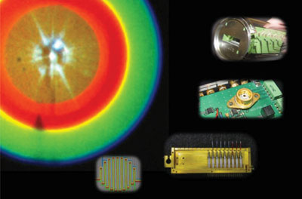

Metrology Of & Metrology Using
Single-Photon Detectors
Alan Migdall
Sergey Polyakov
Jay Fan
Jun Chen
Zachary Levine
Elohim Becerra
Elizabeth Goldschmidt
Joffrey Peters
Natalia Borjemscaia
Boris Glebov
Bill Phillips
Paul Lett
Alberto Marino
Glenn Solomon
Edward Flagg
Andreas Muller
Sae Woo Nam
Rich Mirin
Thomas Gerrits
Shellee Dyer
Burm Baek
Brice Calkins
Adriana Lita
Jeff Van Lanen
Nathan Thomlin
John Lehman
Ming Ming Feng
Anna Fox
Mary Rowe
Manny Knill
Scott Glancy
Josh Bienfang
Allesandro Restelli
Christoph Wildfeuer, LSU
Ivo Degiovanni, INRIM
Kevin Silverman
Martin Stevens
Matthew Eisaman, Brookhaven
Alexander Ling, NUS
Aaron Pearlman, NOAA
Sarah Beavan, ANU
Valentina Schettini, MIT
David Branning, Trinity Col.
Michael Ware, BYU
William Kelly, SJC
Colin McCormick
David Papoular, ENS
NIST, Boulder, CO & Gaithersburg, MD & U. Maryland
  Rochester Institute of Technology, Rochester, NY , Nov 28, 2011

Slide 2
Metrology Of and Metrology Using
Single-Photon Detectors
abstract
Given the tiny energies involved, the generation and detection of one photon at a time is an extraordinary feat. Even with this difficulty, the development of single-photon technology is rapidly advancing. Because this technology involves dealing directly with individual quantum states, it opens up many areas that push the conventional limits, and thus is a strong motivation for this development. One big driver has been the field of quantum information which offers the potential of nothing less than revolutionizing our abilities to calculate here-to-fore intractable calculational problems, to test fundamental principles of the nature, to provide communication where absolute security is based on fundamental physical principles, and to make measurements beyond what are fundamental limits in the classical world. With all this potential, it is no wonder there is such interest in improving single-photon devices.
I will review single photon detector and source technology and some applications. One area of particular interest to us at NIST is their use in metrology. I will present techniques that use this technology for measurements that are not possible any other way and to, in turn, use the techniques made possible by these devices, to characterize the devices themselves. I will also discuss their use in a fundamental test of nature.

Slide 3
Outline
Overview of Single-Photon Detector & Source Technology
Applications of Single-Photon Technology
stuff only possible with single-photon tools
accuracy only possible with single-photon tools
  Quantum Information
    Quantum cryptography
    Quantum computation
  Metrology
    Radiometric measurements of
      sources, detectors, sources by detectors, detectors by sources by detectors
    Position measurements
  Fundamental test
  Future

Slide 4
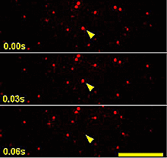
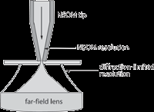
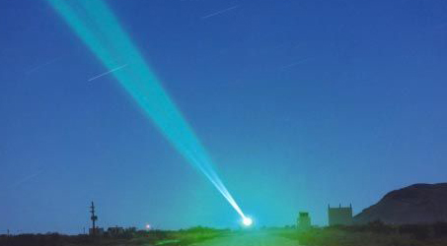
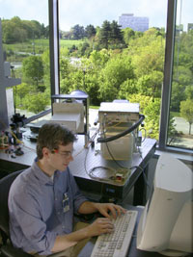
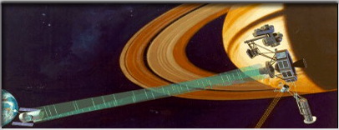
Who cares about single-photons?
Fluorescence Lifetime Imaging
Time resolved single-molecule spectroscopy
Near-field optical microscopy
Light detection and ranging (LIDAR)
Astronomy
Medical diagnostics
Interplanetary communication
Quantum Information
  Computing
  Cryptography
…….
Entanglement

Slide 5
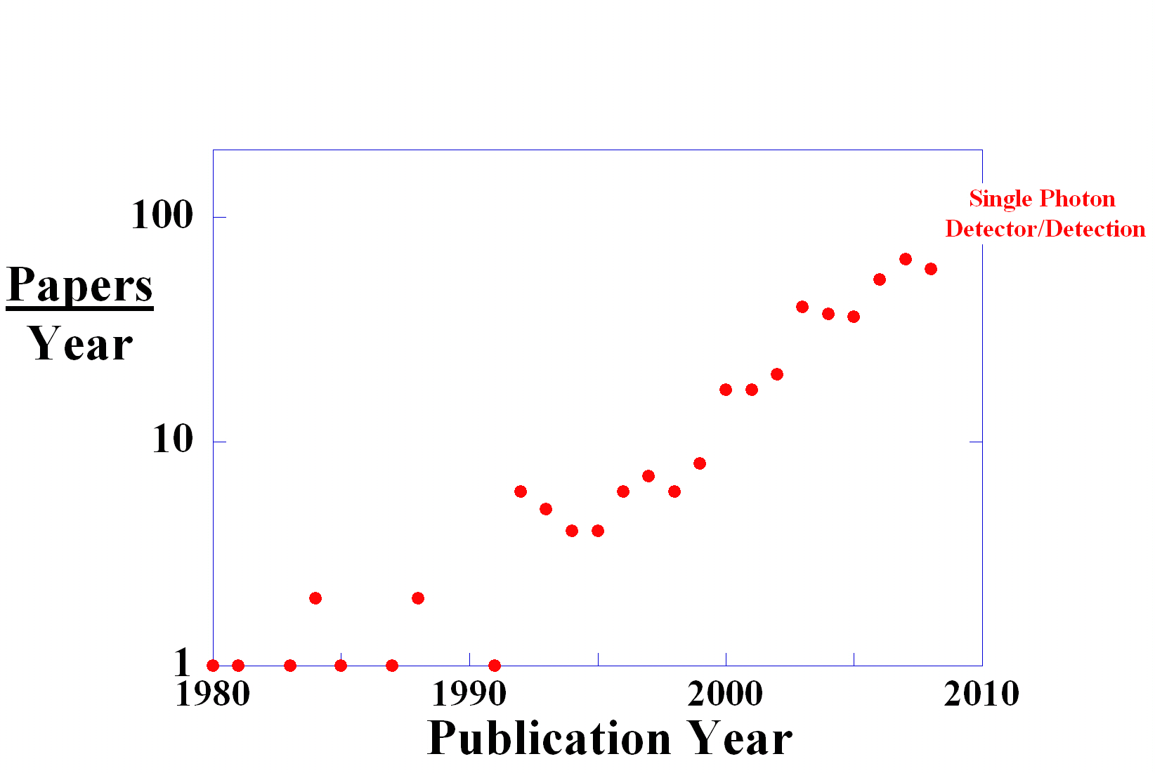
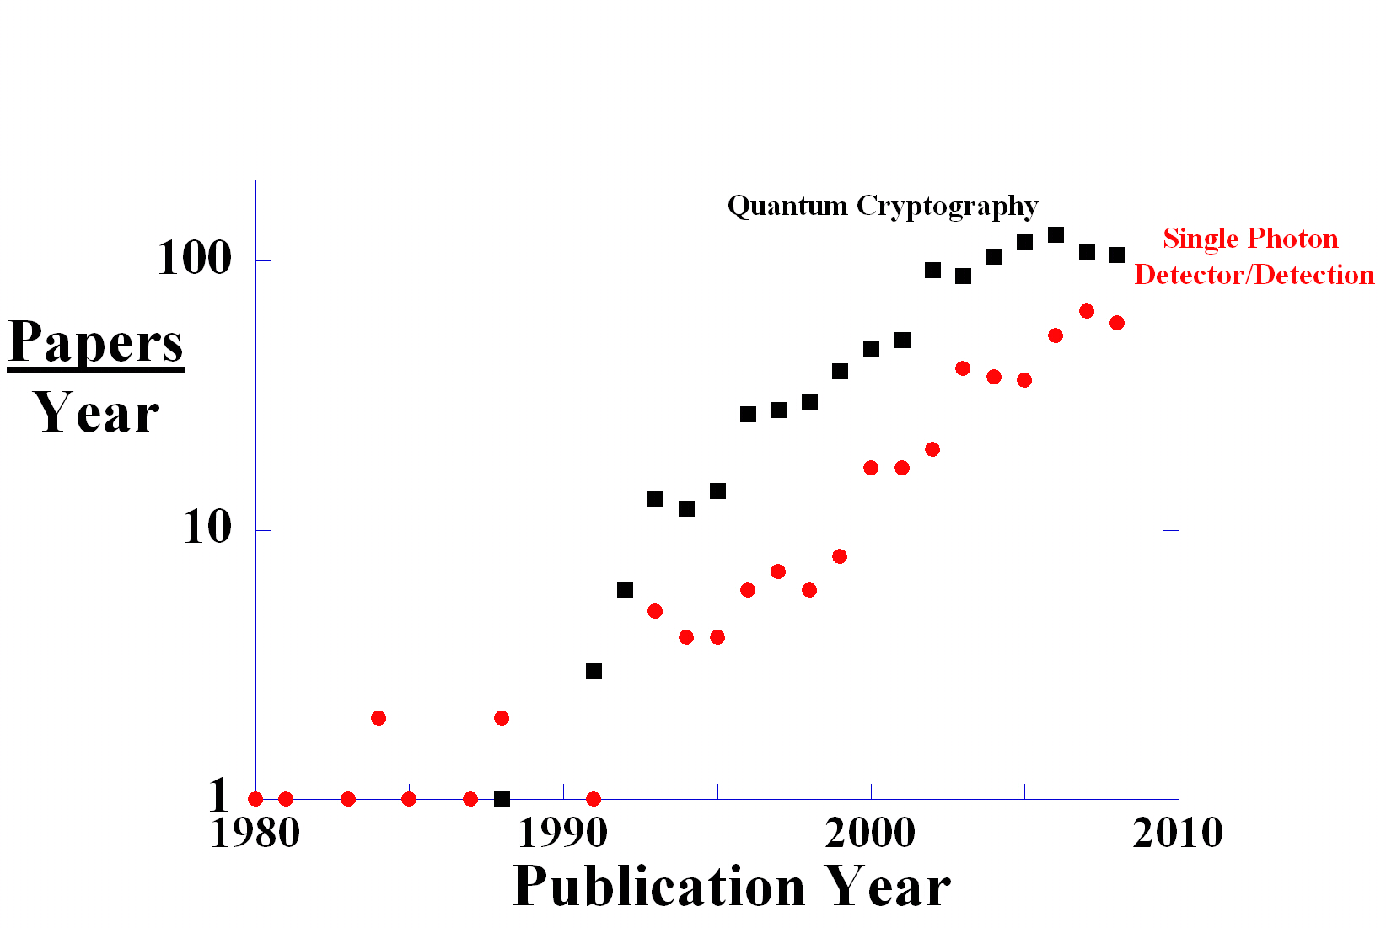
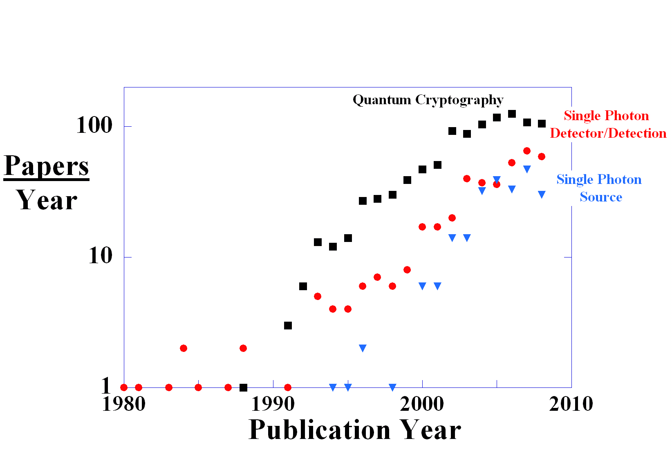
Single Photon Interest

Slide 6
Single Photon?
Visible to Near Infrared
(400 - 1700 nm)
@ λ = 1000 nm
Energy_{photon} ~2x10⁻¹⁹ joules
1 W = 5x10¹⁹ photons/second
(Luminous efficiency ~ 2 to 10%)
Energy_{photon} = h ×ν = h × c /λ
100 W bulb → 2 W light

Slide 7

How small are we talking?
Compare to Mosquito?
~2 mg
E = 2x10⁻⁶ joules
10 cm
g
E_{photon}(λ=1550 nm) ~1.3x10⁻¹⁹ joules
1 = 1.6x10¹³
http://www.hhs.state.ne.us/puh/epi/wnv/links.htm

Slide 8
How to Detect?
Photoelectric Effect
Hertz 1887
Einstein 1905
e⁻
How to detect
a single e⁻ ?
hν
Current

Slide 9
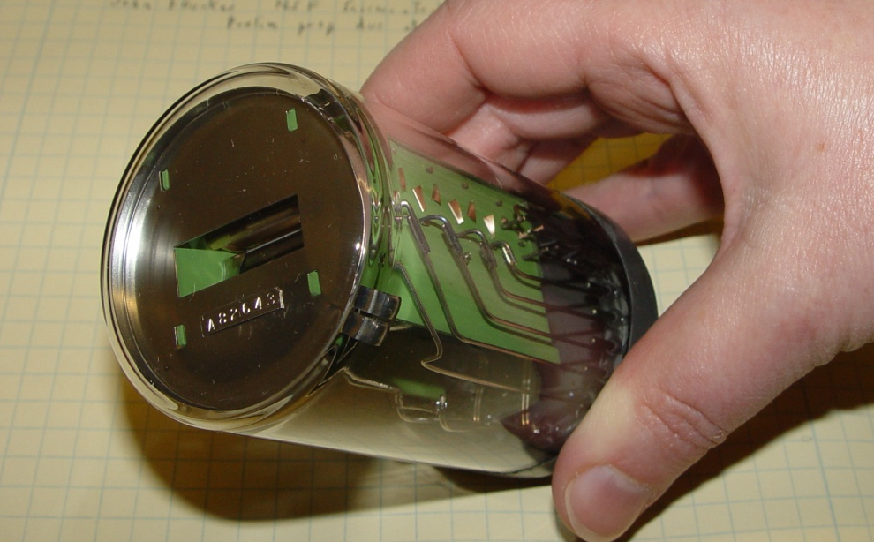
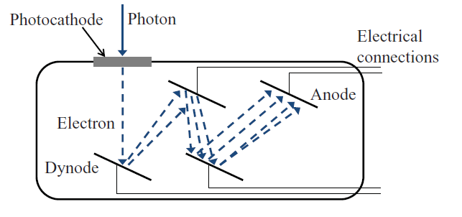
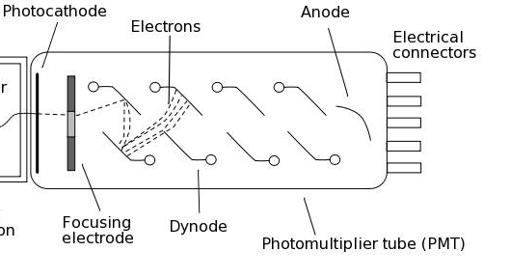
Photomultiplier Tube
1 e⁻ in → 10⁶ e⁻ out
The Secondary Emission Multiplier-A New Electronic Device
V. Zworykin, G. Morton, and L. Malter, Proc. IRE 24, 351 (1935).
First Single-Photon Counting:
K. O. Kiepenheuer, Z. Phys. 107, 145 (1937).
Z. Bay, Nature (London) 141, 1011 (1938).
J. S. Allen, Phys. Rev. 55, 966–971 (1939).
Multiple Amplifier
L. A. Kubetsky, Proc. Inst. Radio Eng. 254, 421 (1937).
The Secondary Emission Phototube
H. Iams and B. Salzberg, Proc. IRE 23, 55 (1935).
Notes:
History ref with reference to
Author’s certificate #24040, priority 4 August 1930 :
http://arxiv.org/ftp/physics/papers/0601/0601159.pdf

Slide 10
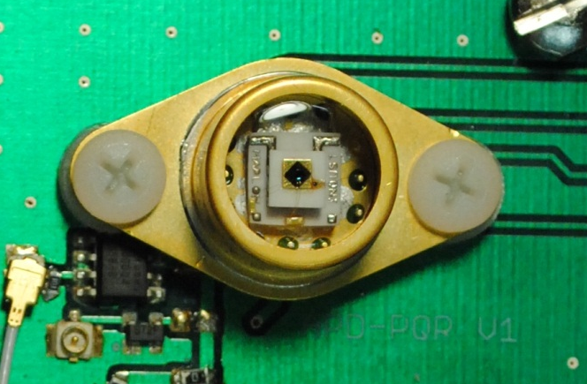
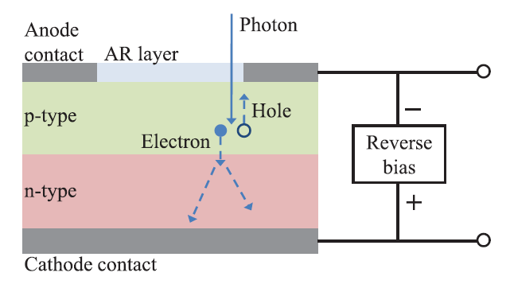
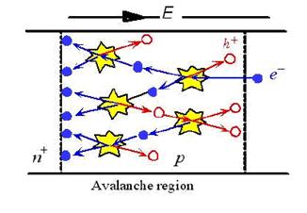
Single-Photon Avalanche Photodiode
V_{bias}
APD
R_{load}
1960s

Slide 11
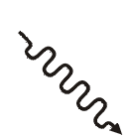
Fundamental Limit
How much gain to do you need?
How small an electrical pulse can you reliably sense?
V_{bias}
Assume:
  Detector capacitance ≈ 1 pF
  Detection Bandwidth ≈ 10 GHz
→ R_{load}C_{Det} ≈ 100 ps → R_{load} ≈ 100 Ω
→Johnson noise
≈ 0.1mV (at R=50 Ω, Τ=300K)
APD
R_{load}
V_{n} = √ 4k_{B}TRΔf
Want low dark count rate ≈ 10⁻⁵ dark count /ns
(thermal fluctuation < photon signal)
→ threshold at 5x Johnson noise ≈ 0.5mV (10⁴ e⁻)
J. Bienfang

Slide 12
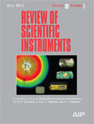
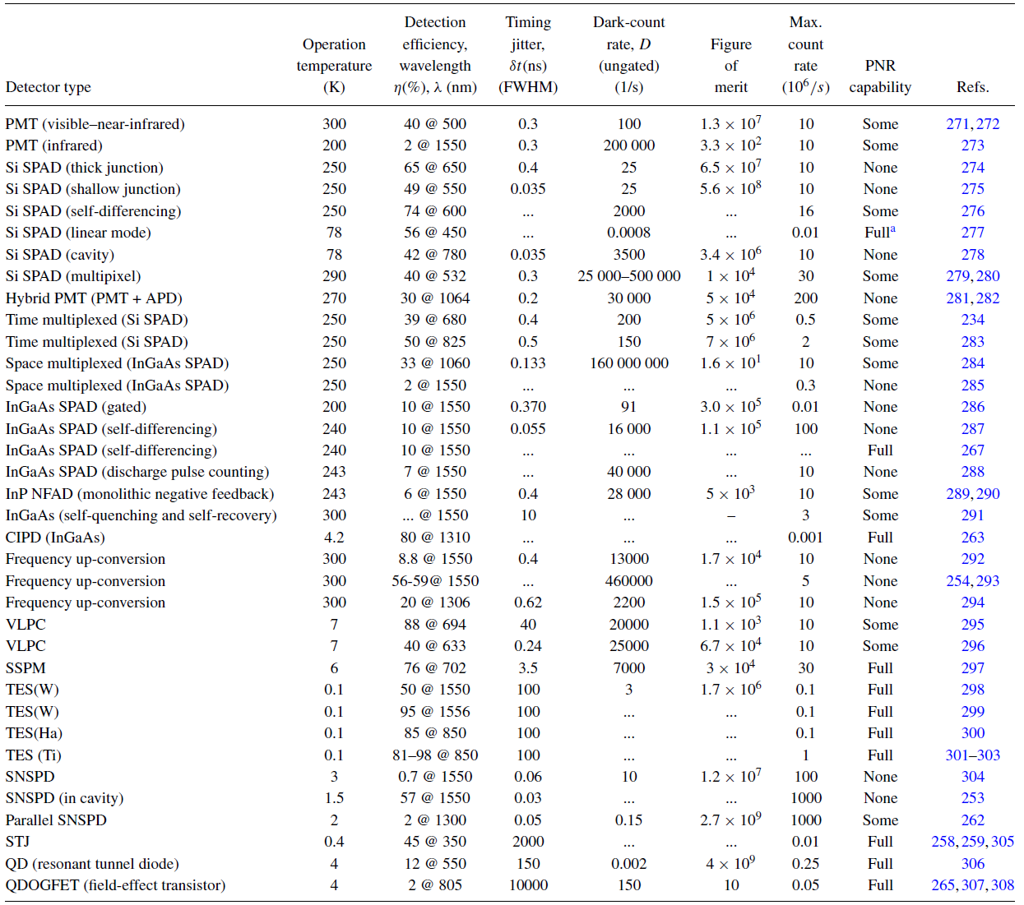


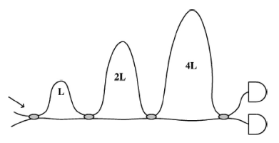
Detectors
RSI Source & Detector Review 82, 071101 (2011)
Photomultiplier tube
Single Photon Avalanche photodiode
  Visible- Silicon
    thick junction
    thin junction
    self differencing
    linear mode
    cavity
    Multipixel
  Infrared
    Gated
    Self differencing
    Discharge pulse
Hybrid
  PMT & APD
  Time multiplexed
  Space multiplexed
infrared- InGaAs

Slide 13
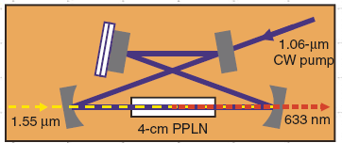



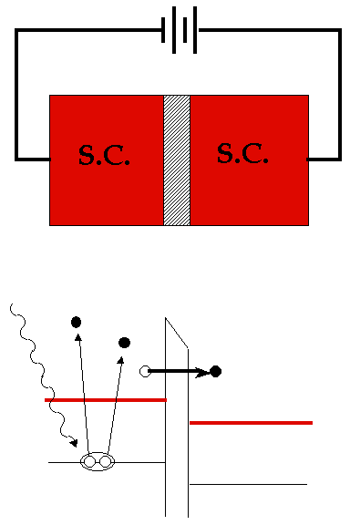
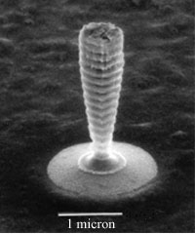
Detectors
RSI Source & Detector Review 82, 071101 (2011)
Photomultiplier tube
Single Photon Avalanche photodiode
  Visible- Silicon
    thick junction
    thin junction
    self differencing
    linear mode
    cavity
    Multipixel
  Infrared
    Gated
    Self differencing
    Discharge pulse
Hybrid
  PMT & APD
  Time multiplexed
  Space multiplexed
infrared- InGaAs
4 nm
niobium nitride

Slide 14
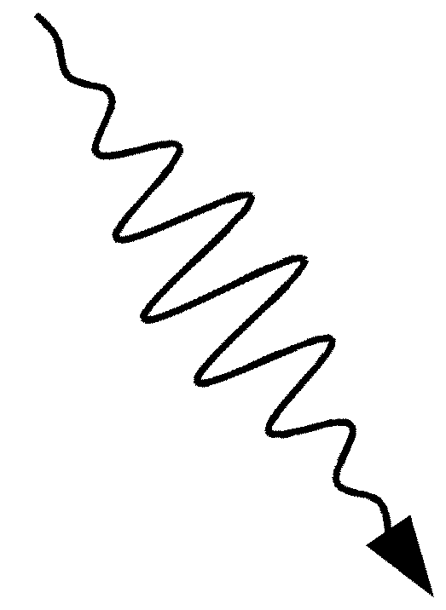
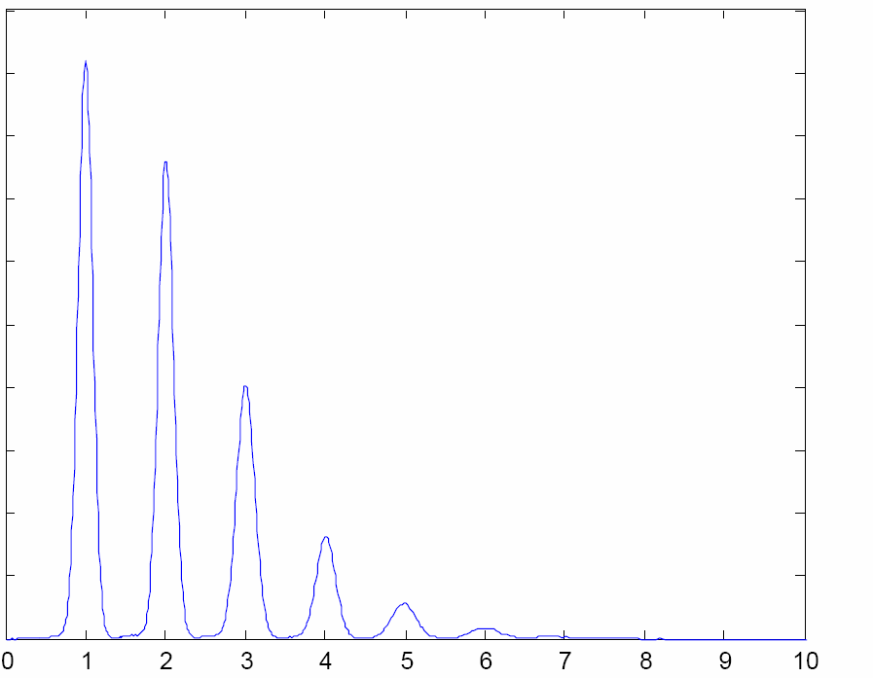

Transition Edge Sensor (TES) Microbolometer
R
R_{n}
Energy
deposition
Thermometer
T
Energy Resolution = 2x10⁻²⁰ J !
Counts
Absorber, C
Wavelength Efficiency
1550 nm ~ 95%
800 nm ~ 99%
Weak thermal link, g
Thermal sink
(50 mK)
Photon #
It Can Really Count Photons
Optimized for photon-number resolution, not speed (τ_{rise}~100 ns, τ_{fall}~1 μs)
Absorption events show good distinguishability
Much slower than APDs
S. Nam

Slide 15


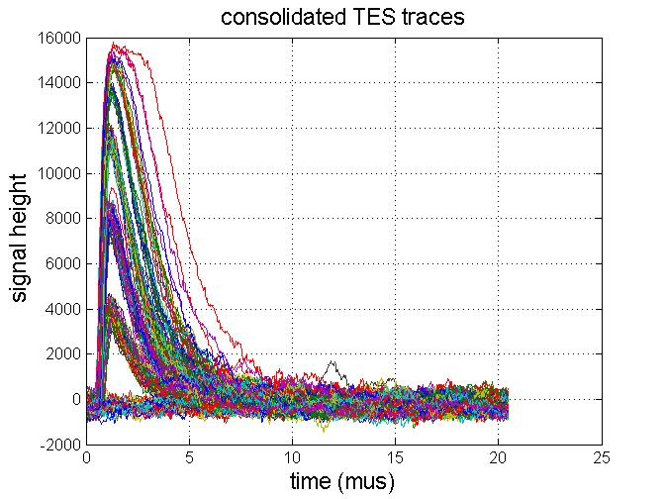
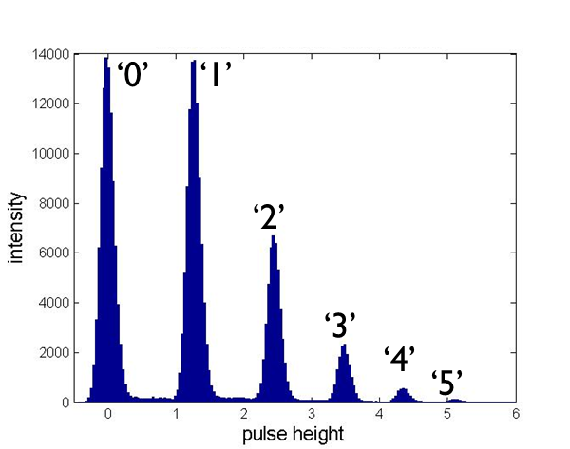
Transition Edge Sensor: pushing the limits
R_{n}
R
I
T
R_{p}
R_{s} ~ 10 mΩ
R_{TES}
I
t

Slide 16
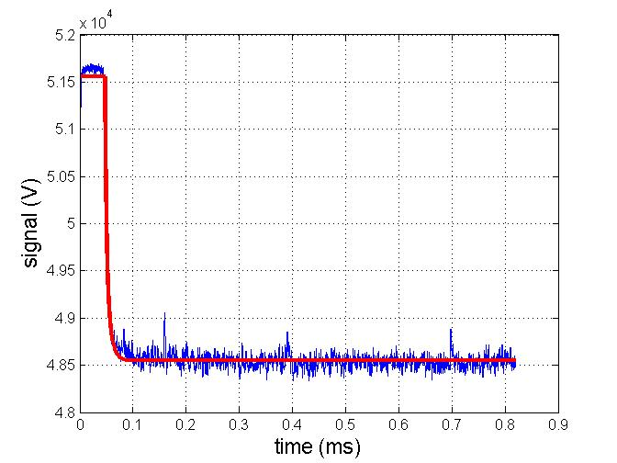
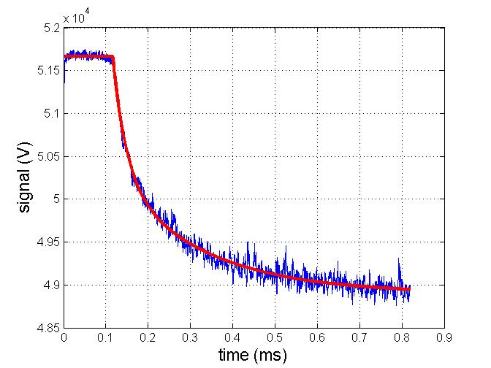
Beyond Single Photon Counting
Temporal Traces
R_{n}
R
I
T
signal (arb. units)
R_{p}
50,000 photons
R_{s} ~ 10 mΩ
~5,000,000 photons
signal (arb. units)
R_{TES}
I
t

Slide 17
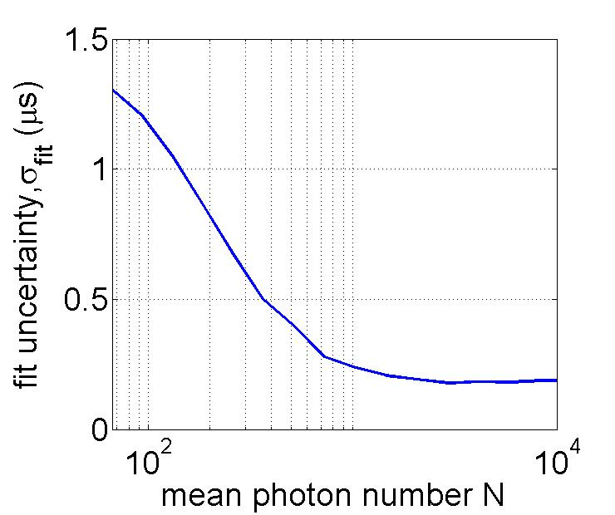
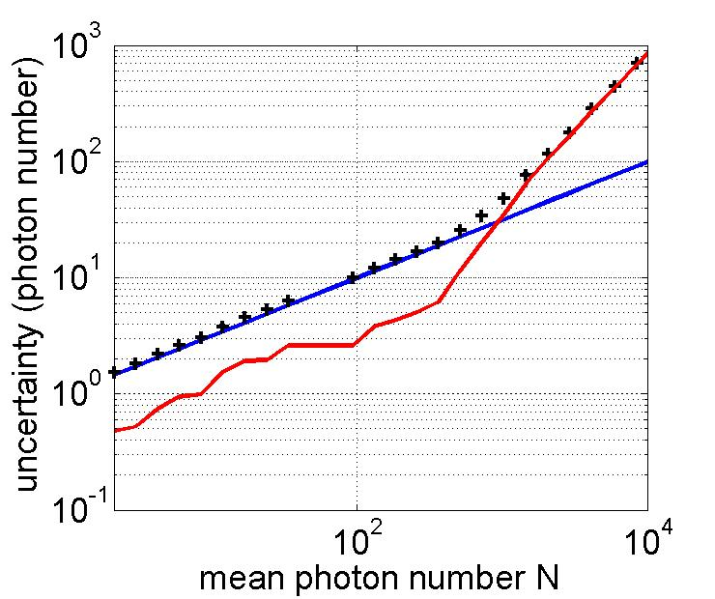
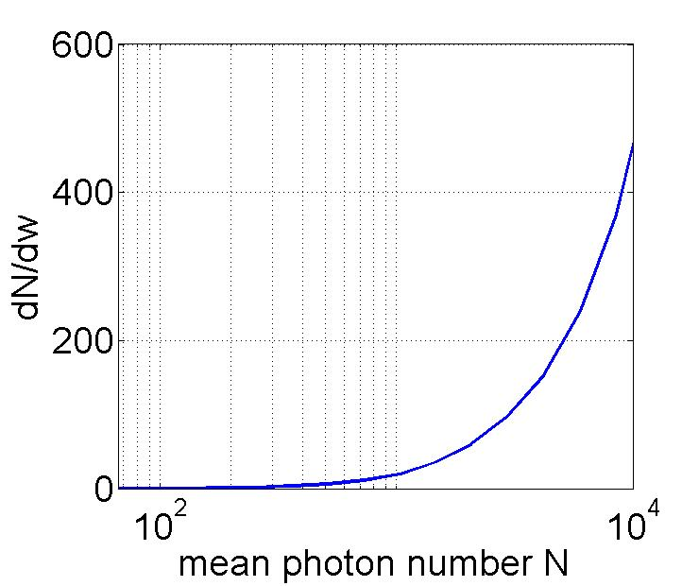
Width uncertainty determination
x
Measured 100 photons
with 3 photons uncertainty
and 94 % quantum efficiency

Slide 18
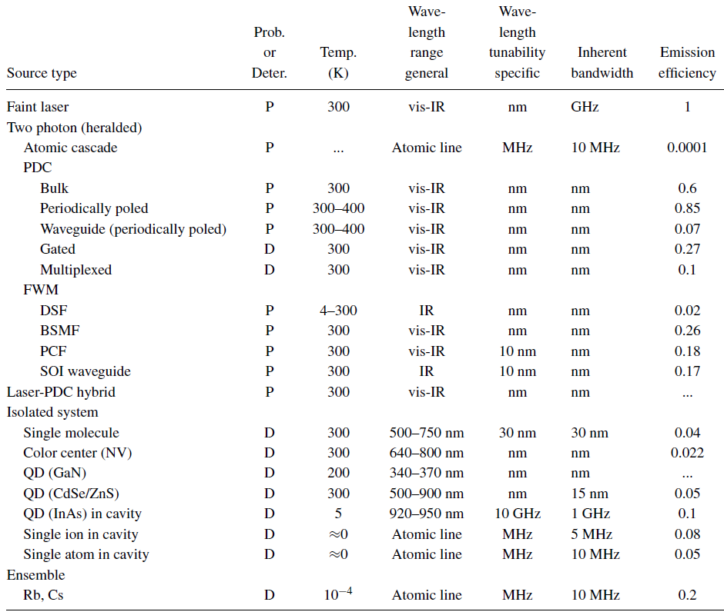
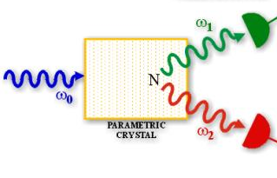
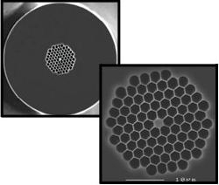
Sources
Laser

Slide 19
Creating light two photons at a time
Optical Parametric Downconversion
One in - two out

Slide 20
Optical Parametric Downconversion

Slide 21
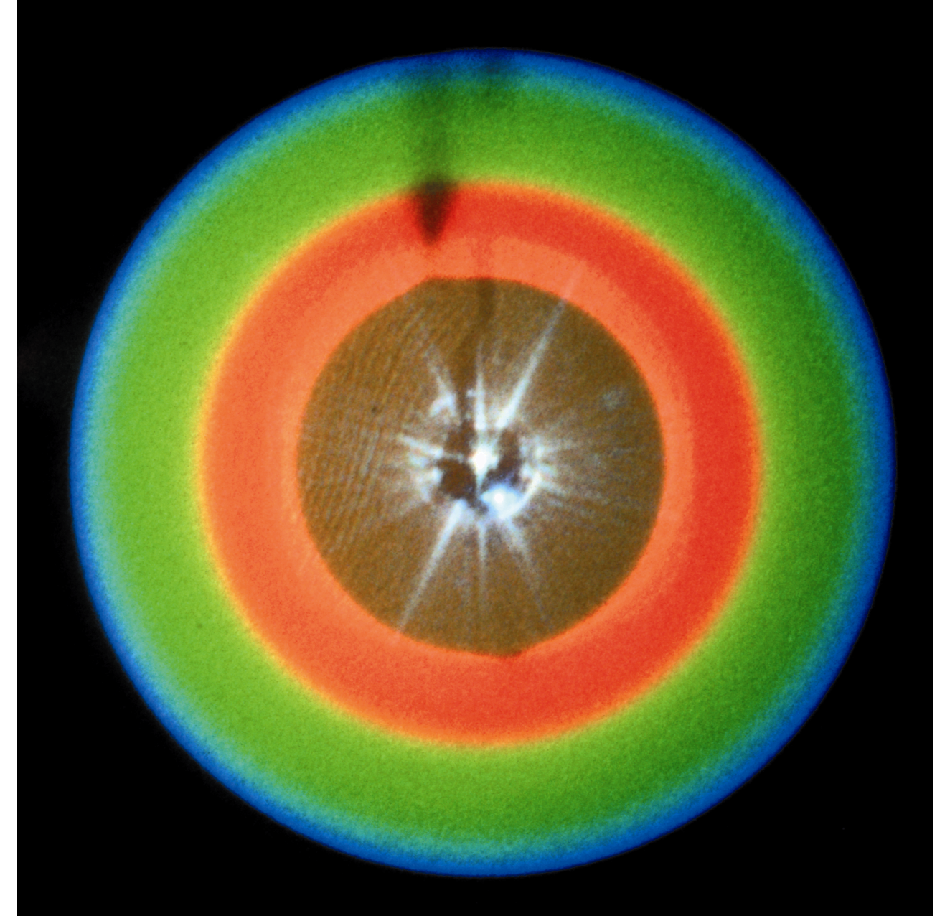

Slide 22
Two-photon light
χ⁽²⁾ parametric down-conversion
  One photon in – two photons out
λ_{pump}= 351 nm

Slide 23
Different
Crystal
Tilts
Produce
Different
Output
Patterns

Slide 24


Slide 25

PDC displaying its own phase matching curve
λ
λ
Calc.

Slide 26
First step to On-Demand production
Pulsed Laser
Laser
fixes random
arrival problem
Attenuator
< 1 photon/pulse
“Heralded” photons
Single Photons only during pulse, but still not really On-Demand

Slide 27
Problem of getting just one
Laser
P₁
P₁
Probability of producing a photon or a pair must be small

Slide 28
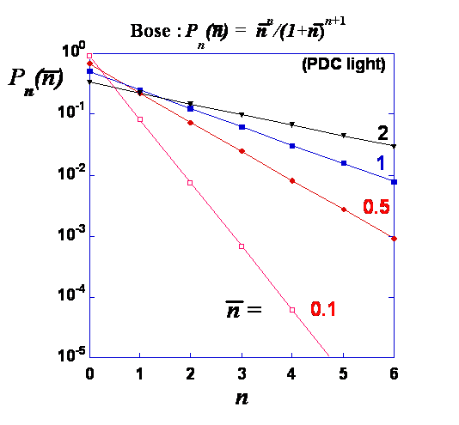
Toward a True Single-Photon Source:
Multiplexed PDC
Separates
P₁ from P_{>1}
Train of N single photons
On demand
Optical Cross Connects
& Delays
Which one information
Pulsed Pump Laser
~ 10% produce a photon pair

Slide 29
Outline
Overview of Single-Photon Detector & Source Technology
Applications with Single-Photon Technology
stuff only possible with single-photon tools
accuracy only possible with single-photon tools
  Quantum Information
    Quantum cryptography
    Quantum computation
  Metrology
    Radiometric measurements
      Sources, detectors, sources by detectors, detectors by sources by detectors
    Position measurements
  Fundamental tests
  Future

Slide 30
Why the interest?
Quantum Information
A convergence of two of the 20th Century’s great revolutions
Quantum Mechanics
(i.e. atoms, photons, molecules)
“Matter”
Information
(i.e. books, data, pictures)
More abstract
Not necessarily material
Quantum Information- via the Superposition Principle:
one N-qubit register can store all 2^{N} numbers!
300 Qbits = 10⁹⁰ - more than all the atoms in the universe!
A quantum computer if it existed could break all present- day public key encryption systems
Quantum encryption can defeat any computational attack

Slide 31
Scaling of Quantum Information
Classically, information stored in a bit register: a 3-bit register stores one number, from 0 – 7.
0
1
0
e.g.
0
0
0
0
0
1
0
1
0
0
1
1
…
1
1
1
2²
2¹
2⁰
Quantum mechanically, a 3-qubit register can store all of these numbers in an arbitrary superposition:
Result:
  Classical: one N-bit number
  Quantum: 2^{N} (all possible) N-bit numbers
300 Qbits = 10⁹⁰ - more than all the atoms in the universe!

Slide 32


Quantum Cryptography–
Alice and Bob need
identical but random keys
B
B
8
4
P
r
o
t
o
c
o
l
B
o
b
'
s
p
o
l
a
r
i
z
a
t
i
o
n
p
i
c
k
0
o
r
1
a
n
a
l
y
z
e
r
s
a
n
d
p
i
c
k
a
b
a
s
i
s
T
w
o
B
a
s
i
s
s
e
t
s
(
a
l
p
h
a
b
e
t
s
)
}
Quantum Channel
Single photon link
p
i
c
k
a
b
a
s
i
s
&
m
e
a
s
u
r
e
t
h
e
n
c
h
e
c
k
A
l
i
c
e
'
s
b
a
s
i
s
v
i
a
c
l
a
s
s
i
c
a
l
c
h
a
n
n
e
l
A
l
i
c
e
'
s
s
i
n
g
l
e
p
h
o
t
o
n
s
o
u
r
c
e
a
n
d
p
o
l
a
r
i
z
a
t
i
o
n
s
e
l
e
c
t
o
r
Physically Secure- Secrecy depends on Laws of
Quantum Mechanics not
a hard calculation
A
l
i
c
e
'
s
b
i
t
v
a
l
u
e
1
0
0
0
1
1
A
l
i
c
e
'
s
p
o
l
a
r
i
z
a
t
i
o
n
B
o
b
'
s
p
o
l
a
r
i
z
a
t
i
o
n
b
a
s
i
s
B
o
b
'
s
r
e
s
u
l
t
1
1
0
0
1
1
S
a
m
e
b
a
s
i
s
?
Y
N
N
Y
N
Y
T
r
a
n
s
m
i
t
t
e
d
k
e
y
1
0
1

Slide 33
What does quantum crypto add?
(disclaimer)
Classical | Quantum
Security depends on hiding large prime factors in really big numbers: “Computational Security” | Security depends on quantum mechanics laws being true: “Physical Security”
Finding large factors of large number is hard today | Physical laws are true today and tomorrow
But… Mathematics has not proven that factoring must be hard | But… this is a belief that cannot be proved the way a mathematical theorem can

Slide 34
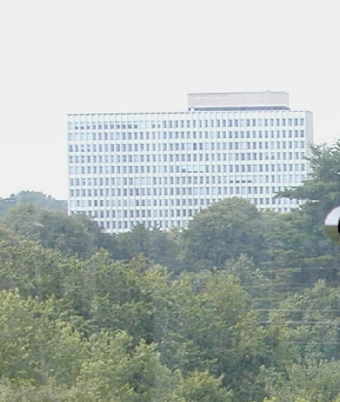
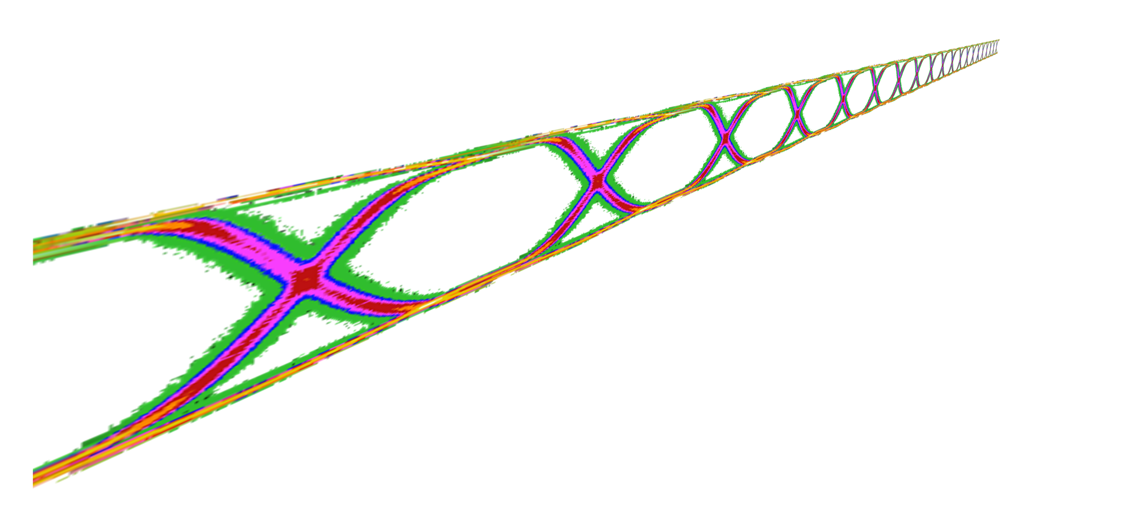




High-speed single-photon signaling
Physical Measurement Laboratory
Josh Bienfang
w/ A. Restelli, J. Galang, A. Migdall, C.W. Clark
X. Tang^{(ITL)}, A. Mink^{(ITL)}

Slide 35
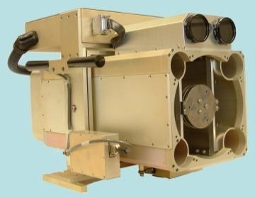
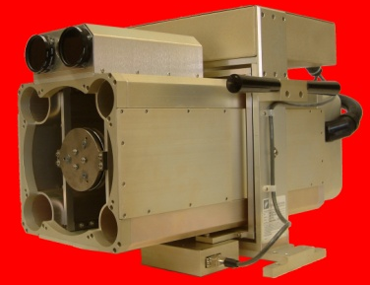
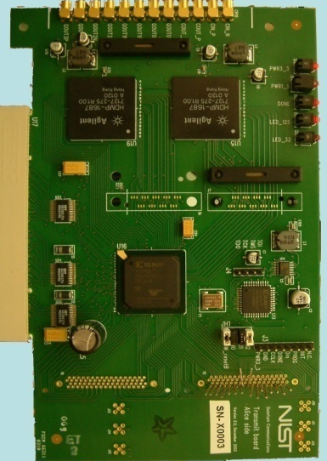
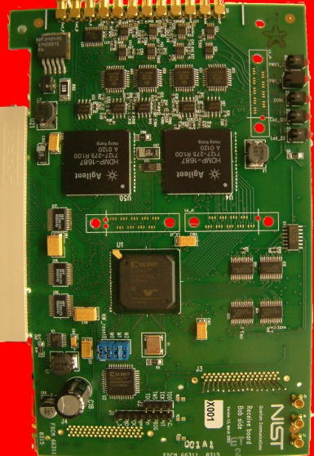
DARPA QuIST QKD Testbed
Testbed for high-speed quantum key distribution
  Si detectors ⇒ Free-space link
Quantum channel
850nm VCSELs
Si APDs
Classical channel
0.8 nsec
Heralded Pulse/Gate
Synchronization: 8b/10b encoding/clock recovery
1.25 Gb/s classical channel defines 0.8 ns gates
Limited by detector jitter and recovery time
Fastest free-space QKD (… known)

Slide 36
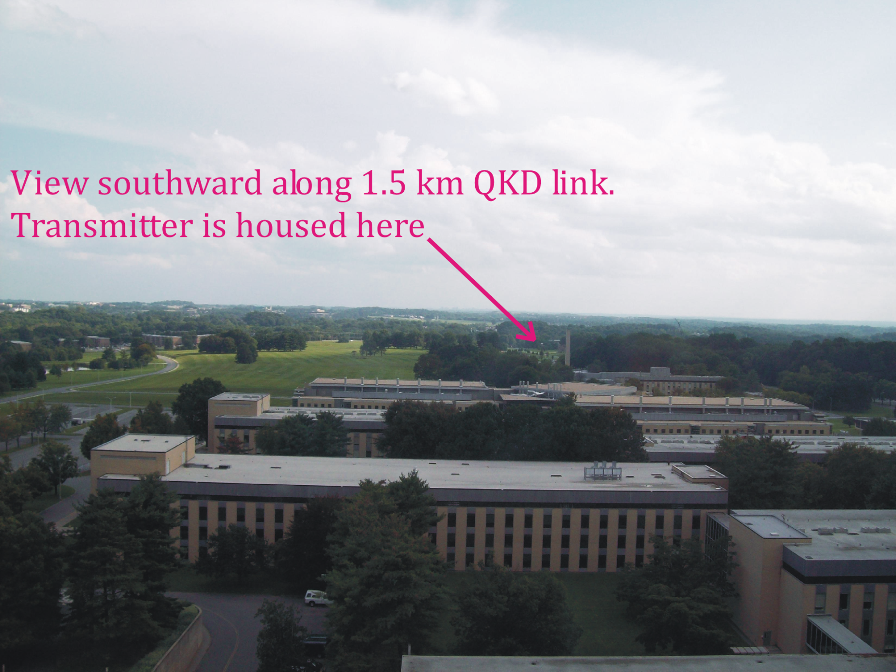
The view from Bob

Slide 37
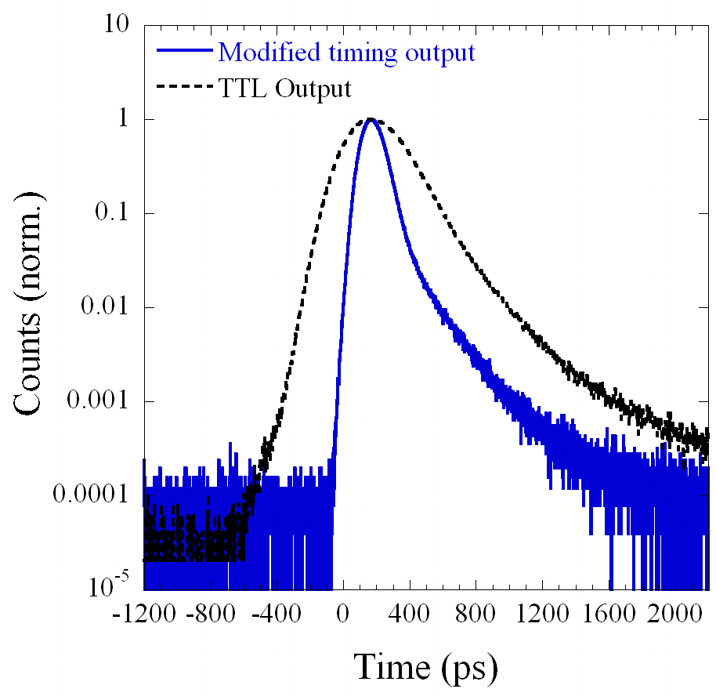
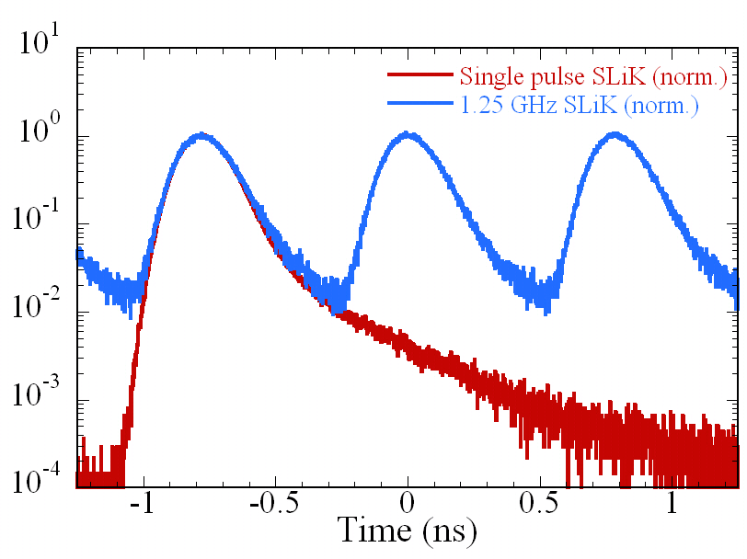
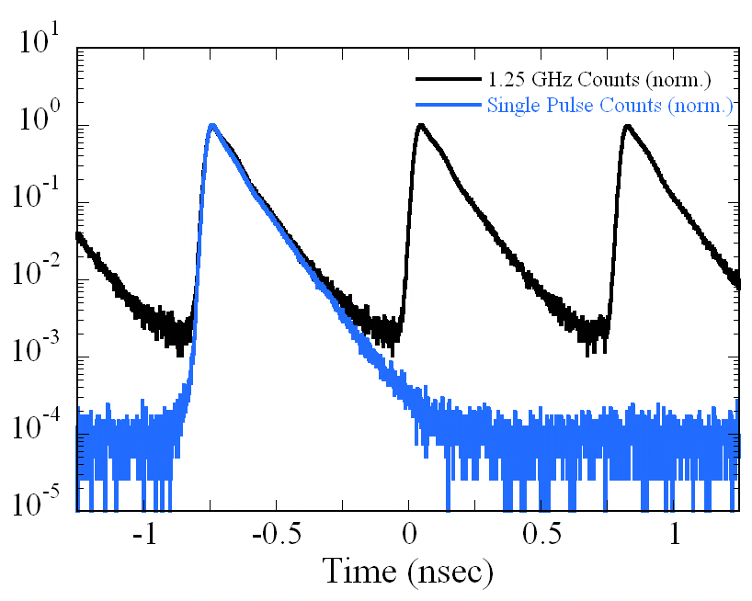
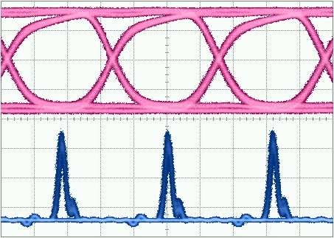
Detector Timing Jitter Issue at 1.25 GHz
1.25 Gbps clock
from Alice
380ps FWHM
1.3ns FW1%M
160ps FWHM
590ps FW1%M
60 ps FWHM
1.25 Gbps optical from Alice – Gain switched VCSELs
Histogram of single-photon arrival times at 1.25 GHz
→ Quantum bit error rate due to detector jitter
<1% @ 1.25 GHz
Collaboration w/
S. Cova et al. at
Politecnico di Milano

Slide 38
Application: Time-Correlated Single-Photon Detection
Ti:Sapphire
Laser
1 ps, 780 nm
Fast Photodiode (Si)
Timing Electronics
Start
BS
82 MHz
780 nm
Mono-
chromator
@ 780 nm
Fiber
SSPD
Stop
Dichroic
BS
>780 nm
Sample
Cryostat
Detector | IRF (FWHM) | Efficiency @ 900 nm | Dark Counts
Conv’l SPAD | 350 ps | 38% | ~50 Hz
Fast SPAD | 40 ps Long tail | 5% | ~50 Hz
SNSPD | 65 ps Gaussian | 2% | <30 Hz
SNSPD
Gaussian response + Few dark counts
→ Tolerate low efficiency
→ Identify multiexponential processes
Stevens et al., APL 89, 031109 (2006)
Notes:
38

Slide 39
Outline
Overview of Single-Photon Detector & Source Technology
Applications with Single-Photon Technology
stuff only possible with single-photon tools
accuracy only possible with single-photon tools
  Quantum Information
    Quantum cryptography
    Quantum computation
  Metrology
    Radiometric measurements
      Sources, detectors, sources by detectors, detectors by sources by detectors
    Position measurements
  Fundamental tests
  Future

Slide 40
Two-Photon Detector Efficiency Scheme
No External Standards Needed!
Detector to be Calibrated
Trigger or “Herald” Detector

Slide 41
Absolute Radiometric Source Standards
Black Body
Synchrotron
Correlated Photon Source

Slide 42
Verifying the Method
A
b
s
o
l
u
t
e
Calibrated
Si Detector
Q
u
a
n
t
u
m
E
f
f
i
c
i
e
n
c
y
Comparison
A
b
s
o
l
u
t
e
C
O
U
N
T
E
R
Q
u
a
n
t
u
m
E
f
f
i
c
i
e
n
c
y
DUT
N
C
O
I
N
C
ω
C
O
U
N
T
E
R
0
P
A
R
A
M
E
T
R
I
C
ω
C
R
Y
S
T
A
L
2
C
O
U
N
T
E
R
Trigger

Slide 43
Turning Two-Photon Method
into Metrology
Sources of uncertainty:
DUT Collection Efficiencies
Spatial
Angular
Spectral
…
Trigger counting
Coincidence determination

Slide 44
Method agreement and confidence bands
Δ

Slide 45
Comparison/Results
NIST implementation of High Accuracy SPD Calibration methods
Uncertainty of each individual comparison:
0.25%
Overall mean difference between the two methods:
0.15%±0.14% (η _{sub.} > η _{2-photon})
Highest accuracy verification of the 2-photon method yet achieved
Method | Absolute uncertainty
Two-photon | 0.18%
Substitution | 0.17%

Slide 46
2-Photon Metrology Progress
Year | 1st author | Uncertainty of |  | External Comparison
 |  | Method | Verification
1970 | Burnham | ~35% |  | Calibrated lamp
1981 | Malygin | -
1986 | Bowman | ~10%
1987 | Rarity | ~10% |  | HeNe + attenuation
1991 | Penin | > 3%
1993 | Ginzburg | ~10% |  | Published values
1994 | Kwiat | ~3%
1995 | Migdall | < 2% | 1% | Calibrated Si Detector
2000 | Brida | ~0.5% | 2% | Calibrated Si Detector
2005 | Ghazi-Bellouati | 1.1, 0.62% | 6.8% | French cryoradiometer
2006 | Wu | 2.1%
2006 | Polyakov | 0.18% | 0.15% | Calibrated Si Detector

Slide 47
Metrology Progress
Our work

Slide 48
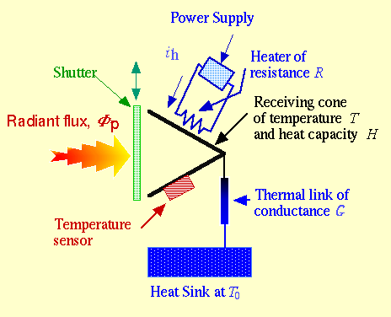
Metrology plans
Moving high accuracy from lab to users
Connecting:
  many-photon radiometry
  to
  single-photon radiometry
Issue: 1 watt ~ 10¹⁹ photon/s

Slide 49
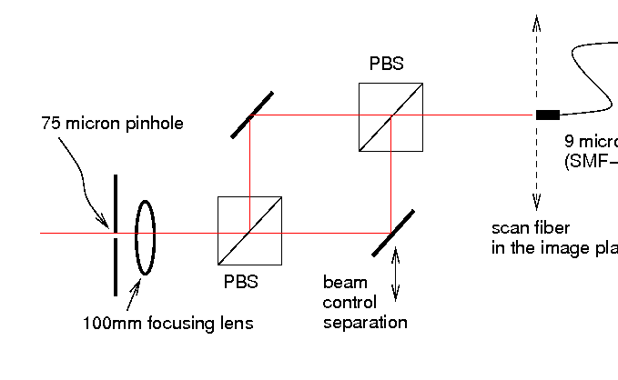
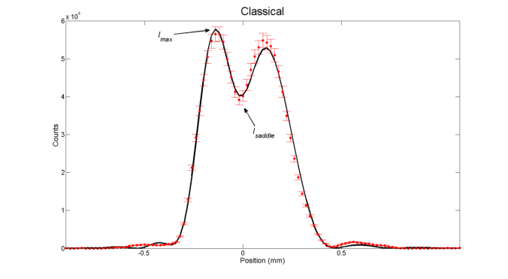

Number-Resolving Detectors & Nonclassical Sources: Tools for Enhanced Measurement
Is enhanced measurement capability possible with just Number-Resolving Detectors?
(motivation: simpler to implement than using both)
Two spots with
better contrast with PNR
Spatial Resolution tested by resolving two adjacent beams
PNR
Length & Spectral Resolution tested with Fabry-Perot Transmittance Spectrum
PNR
Better Resolution with PNR:
transmittance structure allows
better position determination
n=4
Fock state
49
Coherent
state

Slide 50






What additional enhancement is gained with Nonclassical Sources?
Effects of photon source statistics on beam compression?
Gaussian profile
Mean photon number =10
Number-resolved profile
coherent
thermal
Fock, N=10
Number-resolved
spatial profiles
k=10
Fock State source wins but, number-resolved detection with coherent state beats
“classical” detection
k=1
50

Slide 51
Outline
Overview of Single-Photon Detector & Source Technology
Applications with Single-Photon Technology
stuff only possible with single-photon tools
accuracy only possible with single-photon tools
  Quantum Information
    Quantum cryptography
    Quantum computation
  Metrology
    Radiometric measurements
      Sources, detectors, sources by detectors,
      detectors by sources by detectors
    Position measurements
  Fundamental tests
  Future

Slide 52
Chaotic, Pseudo-Thermal Source
CW Diode Laser
1070 nm
Rotating
Ground Glass
Ideal Single-Mode Chaotic Source
g⁽²⁾(0) = 2 g^{(n)}(0,0,…0) = n!
g⁽³⁾(0,0) = 6 g⁽⁴⁾(0,0,0) = 24
Polarizer
Time-Dependent
Speckle
Fast
Photodiode
Oscilloscope
Fiber
Notes:
52

Slide 53
2nd-Order Coherence
CW Diode Laser
1070 nm
Rotating
Ground Glass
Ideal Single-Mode Chaotic Source
g⁽²⁾(0) = 2 g^{(n)}(0,0,…0) = n!
g⁽³⁾(0,0) = 6 g⁽⁴⁾(0,0,0) = 24
ND
Polarizer
Time-Dependent
Speckle
4-element
SNSPD
4-Channel
Time-Tagging
Electronics
PC
Fiber
Closed-Cycle
Cryostat
g⁽²⁾(0) =
1.985 ± 0.019
Multiple detectors allows t=0 measurements
Notes:
53

Slide 54
2nd-Order Coherence
CW Diode Laser
1070 nm
Mirror
Ideal Coherent Source
g⁽²⁾ = 1 g^{(n)} = 1
ND
4-element
SNSPD
4-Channel
Time-Tagging
Electronics
PC
Fiber
Closed-Cycle
Cryostat
Chaotic
Source
Coherent Source (Laser)
Notes:
54

Slide 55
Higher-Order Coherence
CW Diode Laser
1070 nm
Mirror
ND
4-element
SNSPD
4-Channel
Time-Tagging
Electronics
PC
Fiber
Closed-Cycle
Cryostat
Chaotic
Source
g⁽⁴⁾
g⁽³⁾
g⁽²⁾
6
Coherent Source (Laser)
2
Notes:
55

Slide 56
Higher-Order Coherence
Coherent (Avg)
Chaotic (All τ_{i} = 0)
 | Expected | Result | Expected | Result
g⁽²⁾ | 1 | 1.0018 ± 0.0008 | 2 | 1.99 ± 0.02
g⁽³⁾ | 1 | 1.006 ± 0.002 | 6 | 5.9 ± 0.2
g⁽⁴⁾ | 1 | 1.011 ± 0.005 | 24 | 23 ± 2
Chaotic
Source
g⁽⁴⁾
g⁽³⁾
g⁽²⁾
6
Coherent Source
(Laser)
2
Notes:
56

Slide 57

3rd-Order: Chaotic Source
g⁽³⁾(0,0) = 5.87±0.17
Data
Ridges:
g⁽³⁾ ≈ 2
Uncorrelated: g⁽³⁾ ≈ 1
Notes:
57

Slide 58

3rd-Order: Chaotic Source
g⁽³⁾(0,0) = 6
Theory
Ridges:
g⁽³⁾ = 2
Uncorrelated: g⁽³⁾ = 1
Calculation assumes ideal Gaussian scattering process:
P.-A. Lemieux and D. J. Durian, JOSA A 16, 1651 (1999)
Notes:
58

Slide 59

3rd-Order: Coherent Source
Data
Mean value: <g⁽³⁾> = 1.006 ± 0.002
→ Precision measurement of weak cross-correlation
Notes:
59

Slide 60








4th-Order: Chaotic Source
All 4 at once: g⁽⁴⁾(0,0,0) = 23.1±1.8
2 at one time, 2 at another time g⁽⁴⁾ ≈ 4
τ₃ = +5 μs
3 at once
g⁽⁴⁾ ≈ 6
τ₃ = +3 μs
τ₃ = +1 μs
τ₃ = 0
τ₃ = -1 μs
τ₃ = -3 μs
τ₃ = -5 μs
2 Elements fire simultaneously
g⁽⁴⁾ ≈ 2
All 4 at different times g⁽⁴⁾ ≈ 1
Notes:
60

Slide 61
Outline
Overview of Single-Photon Detector & Source Technology
Applications with Single-Photon Technology
stuff only possible with single-photon tools
accuracy only possible with single-photon tools
  Quantum Information
    Quantum cryptography
    Quantum computation
  Metrology
    Radiometric measurements
      Sources, detectors, sources by detectors, detectors by sources by detectors
    Position measurements
  Fundamental tests
  Future

Slide 62



Ontology
2500 years ago…
Ontology (from the Greek nominative ὤν: being, genitive ὄντος: of being (participle of εἶναι: to be) and -λογία: science, study, theory) is a study of conceptions of reality and the nature of being.
Ontology has one basic question: "What exists?" Different philosophers provide different answers to this question.
What is existence? Is existence a property? What does it mean to say something does not exist?
What is an object? Can one give an account of what it means to say that an object exists?
The concept of ontology is generally thought to have originated in early Greece. Before Socrates, questions of being, stasis and change occupied Parmenides and Heraclitus. Parmenides is associated with the view that being must be affirmed and non-being avoided and denied. This is also expressed by Parmenides in the dictum "ἔστι γὰρ εἶναι" or "It is, namely, being."
Despite the seeming straightforwardness of the realist position, in the history of philosophy there has been continuous debate about what is real. In addition, there has been significant evolution in what is meant by the term "real".
Ontology (from the Greek nominative ὤν: being, genitive ὄντος: of being (participle of εἶναι: to be) and -λογία: science, study, theory) is a study of conceptions of reality and the nature of being. In philosophy, ontology is the study of being or existence and forms the basic subject matter of metaphysics. It seeks to describe or posit the basic categories and relationships of being or existence to define entities and types of entities within its framework. It is the science of what is, of the kinds and structures of the objects, properties and relations in every area of reality.
Ontology has one basic question: "What exists?" Different philosophers provide different answers to this question.
What is existence? Is existence a property? What does it mean to say something does not exist? Is existence properly a predicate? Are sentences expressing the existence or non-existence of something properly called propositions?
What is an object? Can one give an account of what it means to say that an object exists?
The concept of ontology is generally thought to have originated in early Greece. Before Socrates, questions of being, stasis and change occupied Parmenides and Heraclitus. Parmenides is associated with the view that being must be affirmed and non-being avoided and denied. This is also expressed by Parmenides in the dictum "ἔστι γὰρ εἶναι" or "It is, namely, being."
Despite the seeming straightforwardness of the realist position, in the history of philosophy there has been continuous debate about what is real. In addition, there has been significant evolution in what is meant by the term "real".

Slide 63
c. 2500 years later….

Slide 64
Bell test hand waving:
classically impossible correlations
measurement
setting
Measurement
result
-1 or 1
A
a
b
B
1 or 2
a
can be measured with instrument set to 1 or 2, and will result in an output of -1 or 1
-1
-1
-1
1
a
b
Hidden variable means that & have predetermined values for each of the measurements
Locality means that either B₁ + B₂ or B₁ - B₂ must equal zero independent of
a
so A₁ (B₁ + B₂) + A₂(B₁ - B₂ ) ≤ 2
Measurements exceed 2
so local hidden variable is ruled out !
rewriting A₁B₁ + A₁B₂ + A₂B₁ - A₂B₂ ≤ 2

Slide 65
Fundamental Problem:
How does the world work?
Realism & Locality ?
Bell’s theorem and experimental tests
  Realism + Locality ⇒ Quantum Phenomena
1935-…
How about Realism + Nonlocality ?
  Leggett’s theorem and experimental tests
  Realism + Nonlocality ⇒ Quantum Phenomena
2003-2007
Realism ≡ Hidden Variable

Slide 66
Perhaps Hidden Variables that are Nonlocal ?

Slide 67
Results using
PDC-based source
FWM-based demonstrated too

Slide 68
Future
Detectors
  Efficiency
  Timing jitter
  Scalability
Sources
  Efficiency
    Extraction
    Generation
  State accuracy
Applications
  Quantum enhanced measurements
  Metrology of & using nonclassical tools
  Fundamental tests
We are always interested in collaborations, students, & postdocs.
(migdall@nist.gov)

